Slide 1
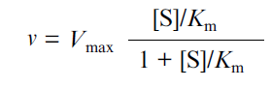
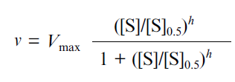
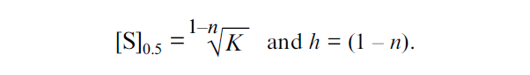
Basic Enzyme Kinetics(hyperbolic enzyme) :
v is the reaction rate, [S] is the initial concentration of the substrate, Vmax is the limiting value of v at saturating concentrations of the substrate (i.e., at [S] →∞), and Km is the Michaelis constant.
Eq. Michaelis Menten
If Km^{eff} = K[S]^{n} , then(sygmoid):
[S]_{0.5} is the “semisaturation” concentration, i.e., the substrate concentration at which v = Vmax/2, and h is the Hill coefficient. At h = 1 this equation is transformed into the classic Michaelis-Menten equation, [S]_{0.5} corresponding to the Michaelis constant Km.
The case when h > 1 corresponds to the S-shaped dependences of v on [S], whereas the case when h < 1 corresponds to the dependence of v on [S] with delayed approaching the limiting value of the enzymatic reaction rate (Vmax) with increasing substrate concentration.
Among three parameters of the Hill equation (Vmax, [S]0.5, and h), only parameter Vmax has clear physical meaning. The other two parameters are used for characterization of the shape of the v versus [S] curve: parameter [S]0.5 characterizes the position of the point at which v = Vmax/2 on the abscissa axis, whereas parameter h characterizes the slope of the straight line in coordinates {log[v/(Vmax . v)]; log[S]}.
Then:
Eq. Hill

